Slide 1



Table of Contents
Course Objectives
Course Program
Trainers Team
Course Schedule
Exams and Evaluation
Learning Resources

Slide 2
Questions
sli.do #mysql

Slide 3
DB Fundamentals Module Goals
4 months intensive database development training
4 times weekly, lots of live coding, homework and projects
Part I – DB Basics
MySQL Server Concepts, SQL, CRUD, table relationships …
Part II – DB Advanced
Spring Data, Hibernate Framework, advanced queries, architecture, working with JSON and XML

Slide 4
Java DB Module at SoftUni – Timeline
22-May-2017
26-Jun-2017
18-Aug-2017
03-Sep-2017
Database
Basics
Lessons + exercises + exam
5 weeks * 4 times / week
9 credits
Start: 22-May-2017
Final exam: 24-June-2017
Database Advanced
Lessons + exercises + teamwork + exam
8 weeks * 4 times / week
18 credits
Start: 26-Jun-2017
Final exam: 13-Aug-2017
Teamwork defense: 18-Aug-2017
SoftUni Vacation
Re-Take Exams
2 exams @ one week

Slide 5


Course Objectives
The Database Basics course provides
Basic database and query concepts
Establishes fundamentals for further DB trainings
Content: SQL syntax, data types, programmability
What is NOT covered?
Client-side implementations
API Libraries

Slide 6


Course Topics
DB intro, concepts overview, functionality
Data definition and data types
Basic CRUD, intro to SQL
Built-in functions
Data aggregation
Table Relations
Subqueries and JOINs
Functions, Triggers, Transactions

Slide 7
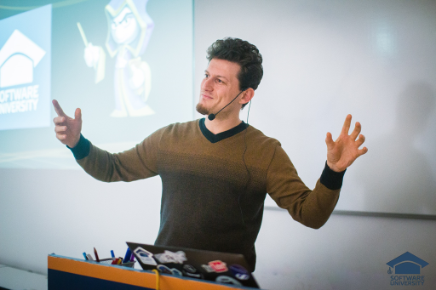
The Trainers Team

Slide 8

Trainers Team
Ivan Ivanov
Technical Trainer @ Software University
Top performing student from the Software University
Develops APIs and Libraries in his spare time
Interests in back-end web development, Spring, Vert.x and Java Technologies in general

Slide 9

Trainers Team (2)
Vasil Peevski
Technical Trainer @ Software University
Senior Java Developer
Interests in education platforms and personal development
Interests in Spring Framework, Hibernate Framework, Maven, Jersey, Jackson, GSon

Slide 10

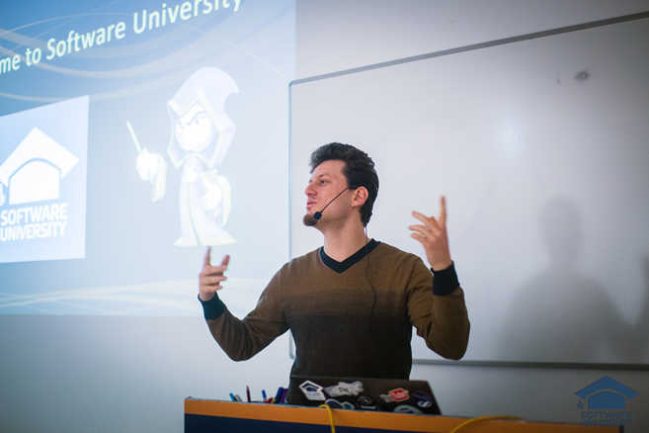
Training Duration and Schedule
Lessons: ~ 20 hours (onsite + YouTube videos)
Practical exercises (in class): ~ 40 hours
Homework: ~ 0-50 hours
Time frame
22-May-2017 – 24-Jun-2017

Slide 11


Your RFID Chip
Students can either
Take RFID chip from SoftUni
Or use their own chip / card (125 KHz)
Register your chip number in your SoftUni profile: https://softuni.bg/users/profile/show
Check-in at the reception every time when you come in SoftUni
See your last visits in your profile: https://softuni.bg/users/profile/show

Slide 12


Scoring System for the Course
Mandatory:
Final exam – 85%
Exercises & homework – 15%
Bonuses:
Presence in class – 5% bonus
Forum activity – bonus up to 5%

Slide 13


Homework Assignments & Exercises
Your homework is mainly work in class!
Lesson days → slides + live demos + exercises
Exercise days → only exercises
How to submit your homework?
Submitted in the judge system
Do your homework when it's due!
Assignments pile up quickly

Slide 14










Resources
What We Need Additionally?

Slide 15



Course Web Site, Forum and FB Group
Official web site:
Official discussion forum:
Official Facebook group:
softuni.bg/trainings/1634/databases-basics-mysql-may-2017
softuni.bg/forum/categories/76
facebook.com/groups/752162754945802/

Slide 16



Recommended Software
Software needed for this course:
MySQL Server & Workbench | HeidiSQL https://dev.mysql.com/downloads/mysql/
IntelliJ IDEA – https://www.jetbrains.com/idea/?fromMenu

